Slide 1
Performance Testing
Lecture 14
Madiha Malik

Slide 2
Performance Testing
Performance testing, a non-functional testing technique performed to determine the system parameters in terms of responsiveness and stability under various workload.
Performance testing measures the quality attributes of the system, such as scalability, reliability and resource usage.

Slide 3
Performance Testing
Performance Testing is defined as a type of software testing to ensure software applications will perform well under their expected workload.
Features and Functionality supported by a software system is not the only concern.
A software application's performance like its response time, reliability, resource usage and scalability do matter.
The goal of Performance Testing is not to find bugs but to eliminate performance bottlenecks.

Slide 4
Performance Testing?
Performance Testing uncovers what needs to be improved before the product goes to market.
Speed - Determines whether the application responds quickly
Scalability - Determines maximum user load the software application can handle.
Stability - Determines if the application is stable under varying loads
Performance Testing is popularly called “Perf Testing” and is a subset of performance engineering.
Notes:
Performance Testing is done to provide stakeholders with information about their application regarding speed, stability, and scalability. More importantly, Performance Testing uncovers what needs to be improved before the product goes to market.

Slide 5
Why do Performance Testing?
Without Performance Testing, software is likely to suffer from issues such as:
running slow while several users use it simultaneously,
inconsistencies across different operating systems and
poor usability.

Slide 6
Why do Performance Testing?
Applications sent to market with poor performance metrics due to non-existent or poor performance testing are likely to gain a bad reputation and fail to meet expected sales goals.
Mission-critical applications like space launch programs or life-saving medical equipment should be performance tested to ensure that they run for a long period without deviations.

Slide 7
Why do Performance Testing?
59% of Fortune 500 companies experience an estimated 1.6 hours of downtime every week. Considering the average Fortune 500 company with a minimum of 10,000 employees is paying $56 per hour, the labour part of downtime costs for such an organization would be $896,000 weekly, translating into more than $46 million per year.
Notes:
Each year, Fortune ranks the world's top companies and executives.

Slide 8
Why do Performance Testing?
Only a 5-minute downtime of Google.com (19-Aug-13) is estimated to cost the search giant as much as $545,000.
It's estimated that companies lost sales worth $1100 per second due to a recent Amazon Web Service Outage.
Hence, performance testing is important.

Slide 9
Types of Performance Testing
Load Testing
Stress Testing
Endurance Testing
Spike Testing
Volume Testing
Scalability Testing

Slide 10
Types of Performance Testing
Load testing - checks the application's ability to perform under anticipated user loads. The objective is to identify performance bottlenecks before the software application goes live.
Stress testing - involves testing an application under extreme workloads to see how it handles high traffic or data processing. The objective is to identify the breaking point of an application.
Endurance testing - is done to make sure the software can handle the expected load over a long period of time.

Slide 11
Types of Performance Testing
Spike testing - tests the software's reaction to sudden large spikes in the load generated by users.
Volume testing - Under Volume Testing large no. of. Data is populated in a database and the overall software system's behavior is monitored. The objective is to check software application's performance under varying database volumes.
Scalability testing - The objective of scalability testing is to determine the software application's effectiveness in "scaling up" to support an increase in user load. It helps plan capacity addition to your software system.

Slide 12
Common Performance Problems
Most performance problems revolve around speed, response time, load time and poor scalability.
Speed is often one of the most important attributes of an application.
A slow running application will lose potential users.
Performance testing is done to make sure an app runs fast enough to keep a user's attention and interest.

Slide 13
Common Performance Problems
Long Load Time
Poor Response Time
Poor Scalability
Bottlenecking

Slide 14
Common Performance Problems
Long Load Time - the initial time it takes an application to start.
Poor Response Time - time it takes from when a user inputs data into the application until the application outputs a response to that input
Poor Scalability - when it cannot handle the expected number of users or when it does not accommodate a wide enough range of users

Slide 15
Common Performance Problems
Bottlenecking - obstructions in a system which degrade overall system performance.
It is when either coding errors or hardware issues cause a decrease of throughput under certain loads
caused by one faulty section of code
fixing a bottlenecking issue is to find the section of code that is causing the slowdown and try to fix it there.
generally fixed by either fixing poor running processes or adding additional Hardware

Slide 16
Common Performance Problems
Common performance bottlenecks are:
CPU utilization
Memory utilization
Network utilization
Operating System limitations
Disk usage

Slide 17
Performance Testing Metrics
Processor Usage - an amount of time processor spends executing non-idle threads.
Memory use - amount of physical memory available to processes on a computer.
Disk time - amount of time disk is busy executing a read or write request.
Bandwidth - shows the bits per second used by a network interface.
Private bytes - number of bytes a process has allocated that can't be shared amongst other processes. These are used to measure memory leaks and usage.
Committed memory - amount of virtual memory used.

Slide 18
Performance Testing Metrics
Memory pages/second - number of pages written to or read from the disk in order to resolve hard page faults. Hard page faults are when code not from the current working set is called up from elsewhere and retrieved from a disk.
Page faults/second - the overall rate in which fault pages are processed by the processor. This again occurs when a process requires code from outside its working set.
CPU interrupts per second - is the avg. number of hardware interrupts a processor is receiving and processing each second.
Disk queue length - is the avg. no. of read and write requests queued for the selected disk during a sample interval.

Slide 19
Performance Testing Metrics
Network output queue length - length of the output packet queue in packets. Anything more than two means a delay and bottlenecking needs to be stopped.
Network bytes total per second - rate which bytes are sent and received on the interface including framing characters.
Response time - time from when a user enters a request until the first character of the response is received.
Throughput - rate a computer or network receives requests per second.
Amount of connection pooling - the number of user requests that are met by pooled connections. The more requests met by connections in the pool, the better the performance will be.

Slide 20
Performance Testing Metrics
Maximum active sessions - the maximum number of sessions that can be active at once.
Hit ratios - This has to do with the number of SQL statements that are handled by cached data instead of expensive I/O operations. This is a good place to start for solving bottlenecking issues.
Hits per second - the no. of hits on a web server during each second of a load test.
Rollback segment - the amount of data that can rollback at any point in time.
Database locks - locking of tables and databases needs to be monitored and carefully tuned.

Slide 21
Performance Testing Metrics
Top waits - are monitored to determine what wait times can be cut down when dealing with the how fast data is retrieved from memory
Thread counts - An applications health can be measured by the no. of threads that are running and currently active.
Garbage collection - It has to do with returning unused memory back to the system. Garbage collection needs to be monitored for efficiency.

Slide 22
Performance Testing Tools
LoadNinja
NeoLoad
HPLoadRunner
Jmeter

Slide 23
How to Use JMeter for Performance & Load Testing
Apache JMeter testing tool offers following benefit in Performance Testing
Used to test the performance of both static resources such as JavaScript and HTML, as well as dynamic resources, such as JSP, Servlets, and AJAX.
Can discover maximum number of concurrent users that your website can handle
Provides a variety of graphical analyses of performance reports.

Slide 24
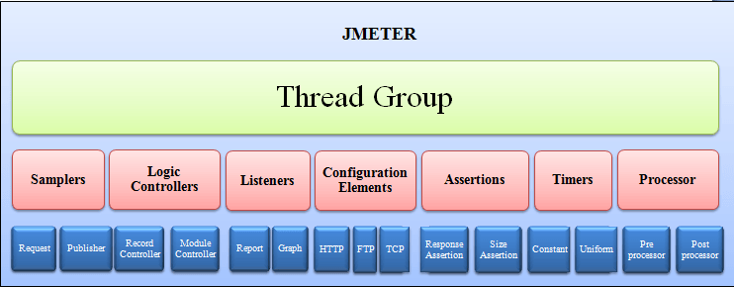

Slide 25
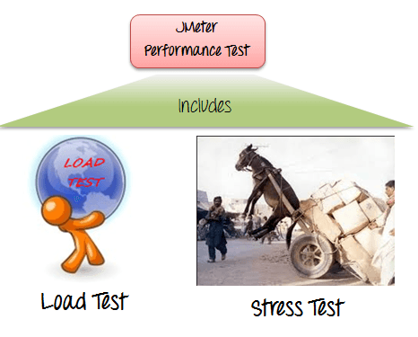
JMeter Performance Testing

Slide 26
JMeter Performance Testing
Load Testing: Modelling the expected usage by simulating multiple user access the Web services concurrently.
Stress Testing: Every web server has a maximum load capacity. When the load goes beyond the limit, the web server starts responding slowly and produce errors. The purpose of the Stress Testing is to find the maximum load the web server can handle.

Slide 27
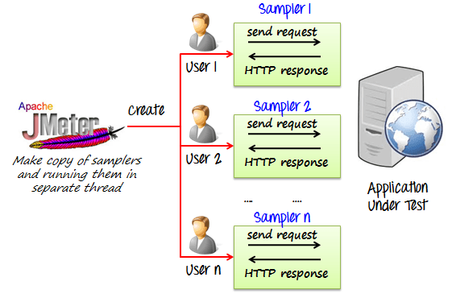
How JMeter Load Testing simulates the heavy load

Slide 28
Create a Performance Test Plan in JMeter
Doing a performance analysis of Google.com for 1000 users
Before testing the performance of target web application, we should determine-
Normal Load: Average number of users visit your website
Heavy Load: The maximum number of users visit your website
What is your target in this test?

Slide 29
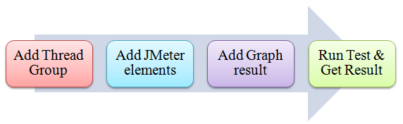
Roadmap of Example

Slide 30
JMeter Performance Testing
Step 1) Add Thread Group
Start JMeter
Select Test Plan on the tree
Add Thread Group
Right click on the "Test Plan" and add a new thread group:
Add -> Threads (Users) -> Thread Group

Slide 31
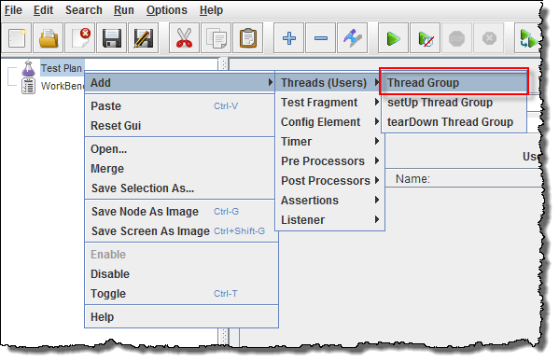

Slide 32
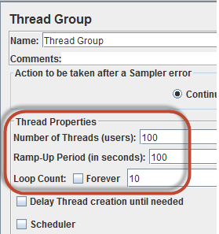
In the Thread Group control panel, enter Thread Properties
Number of Threads: 100 (Number of users connects to the target website: 100)
Loop Count: 10 (Number of time to execute testing)
Ramp-Up Period: 100 (How long to delay before starting the next user)
For example, if we have 100 users and a 100-second Ramp-Up period, then the delay between starting users would be 1 second (100 seconds /100 users)

Slide 33
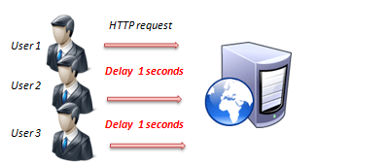
Ramp-up Period

Slide 34
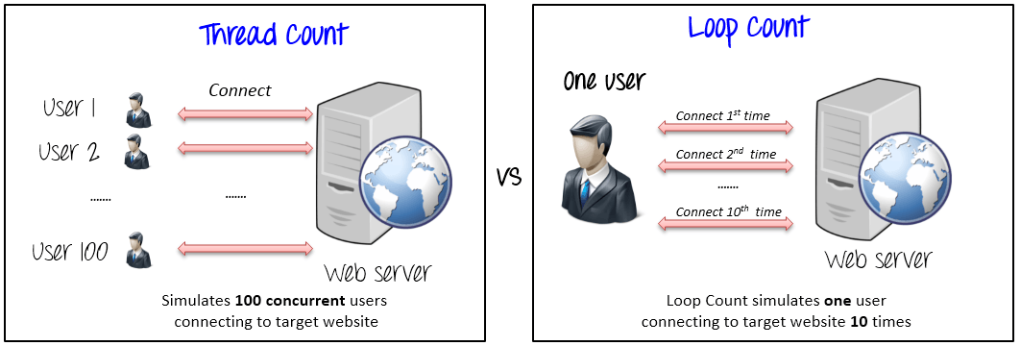
Thread Count and Loop Count

Slide 35
JMeter Performance Testing
Step 2) Adding JMeter elements
HTTP request Default
HTTP Request

Slide 36
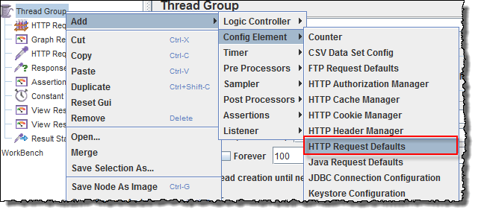
JMeter Elements
HTTP request Default

Slide 37
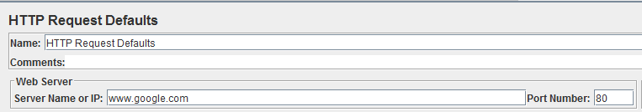
In the HTTP Request Defaults control panel, enter the Website name under test (http://www.google.com)

Slide 38
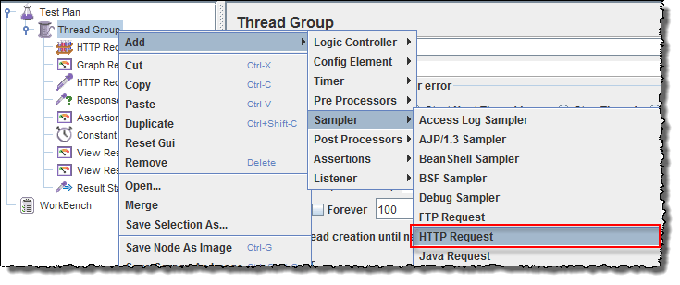
JMeter Elements
HTTP Request

Slide 39
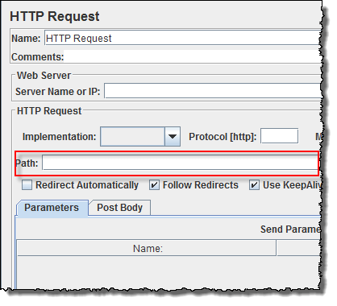

Slide 40
In HTTP Request Control Panel, the Path field indicates which URL request you want to send to Google server.
For example, if you enter "calendar" in Path field. JMeter will create the URL request http://www.google.com/calendar to Google server
If you keep the Path field blank JMeter will create the URL request http://www.google.com to Google server.
In this test, you keep the Path field blank to make JMeter create the URL request http://www.google.com to Google server.

Slide 41
JMeter-Listener
Step 3) Adding Graph result
JMeter can show the test result in Graph format.
Right click Test Plan, Add -> Listener -> Graph Results

Slide 42
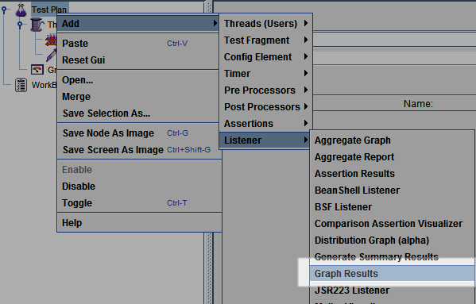

Slide 43
JMeter - Performance Testing
Step 4) Run Test and get the test result
Press the Run button (Ctrl + R) on the Toolbar to start the software testing process. You will see the test result display on Graph in the real time.

Slide 44
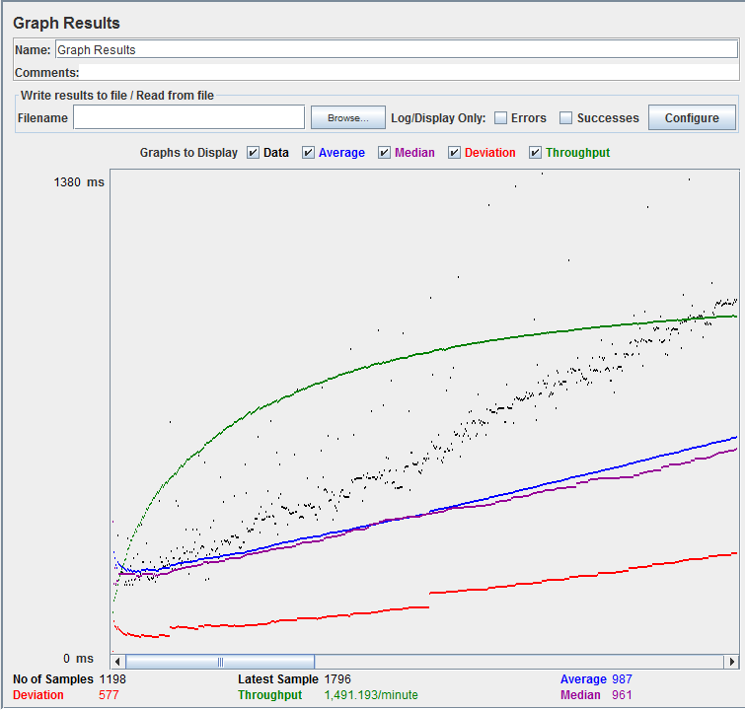

Slide 45
Parameters
Black: The total number of current samples sent.
Blue: The current average of all samples sent.
Red: The current standard deviation.
Green: Throughput rate that represents the number of requests per minute the server handled

Slide 46
Parameters
The Throughput is the most important parameter. It represents the ability of the server to handle a heavy load. The higher the Throughput is, the better is the server performance.
In this test, the throughput of Google server is 1,491.193/minute. It means Google server can handle 1,491.193 requests per minute. This value is quite high so we can conclude that Google server has good performance
The deviation is shown in red - it indicates the deviation from the average. The smaller the better. (577)

Slide 47
Let compare the performance of Google server to other web servers. This is the performance test result of website http://www.yahoo.com/ (You can choose other websites)
The throughput of a website under test http://www.yahoo.com is 867.326/minutes. It means this server handle 867.326 requests per minute, lower than Google.
The deviation is 2689, much higher than Google (577). So we can determine the performance of this website is less than a Google server.

Slide 48
Troubleshooting
If you face the issue while running the above scenario ... do the following
Check whether you are connecting to the internet via a proxy. If yes, remove the proxy.
Open a new instance of Jmeter
Open the PerformanceTestPlan.jmx in Jmeter
Double Click on Thread Group -> Graph Result
Run the Test

